Slide 1

Graduation Project
Examination System for EDU HUB Platform
Supervisor:
Eng. Rami Nagi
Notes:
ID=d924773e-9a16-4d6d-9803-8cb819e99682 Recipe=text_billboard Type=TextOnly Variant=0 FamilyID=AccentBoxWalbaum_Zero

Slide 2

Team Work
Ahmed Adel Rashad
Ali Mohamed Ali
Tarek Ebrahim Abdelkader
Mahmoud Ibrahim Mohahmed

Slide 3
The Project
Key Objectives:
Design and implement a relational SQL database:
Store student information, exam details, and course structures
Implement stored procedures for various functionalities:
Insert, update, delete records
Exam generation, answer submission, exam correction
Generate detailed reports to monitor:
Student progress, course performance, exam outcomes
Create Power BI dashboards for visualizing key metrics
Examination System for EDU HUB Platform
Automated online exam system for the EDU HUB platform
Efficient and scalable solution for managing exams

Slide 4
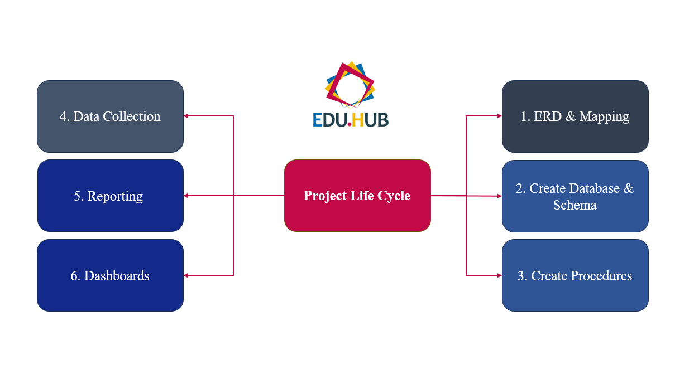
The way to get started is to quit talking and begin doing.
Project Life Cycle

Slide 5

1. ERD & Mapping

Slide 6
1. ERD & Mapping | ERD
Key activities during this phase included:
Identifying entities and attributes.
Defining relationships and constraints.
Ensuring data normalization and integrity.

Slide 7
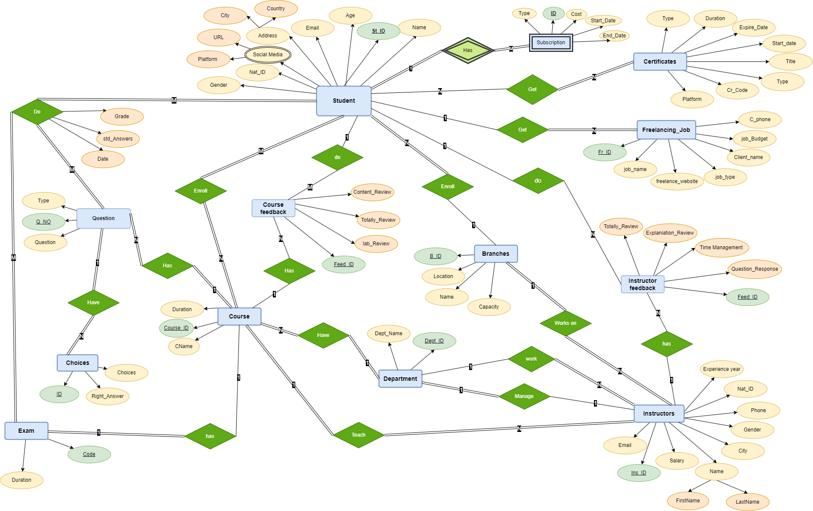

Slide 8
1. ERD & Mapping | Mapping
Once the ERD was finalized, the next step was to map the entities and relationships from the diagram into a physical database schema.
This involved defining tables, columns, data types, and constraints in an SQL environment.

Slide 9
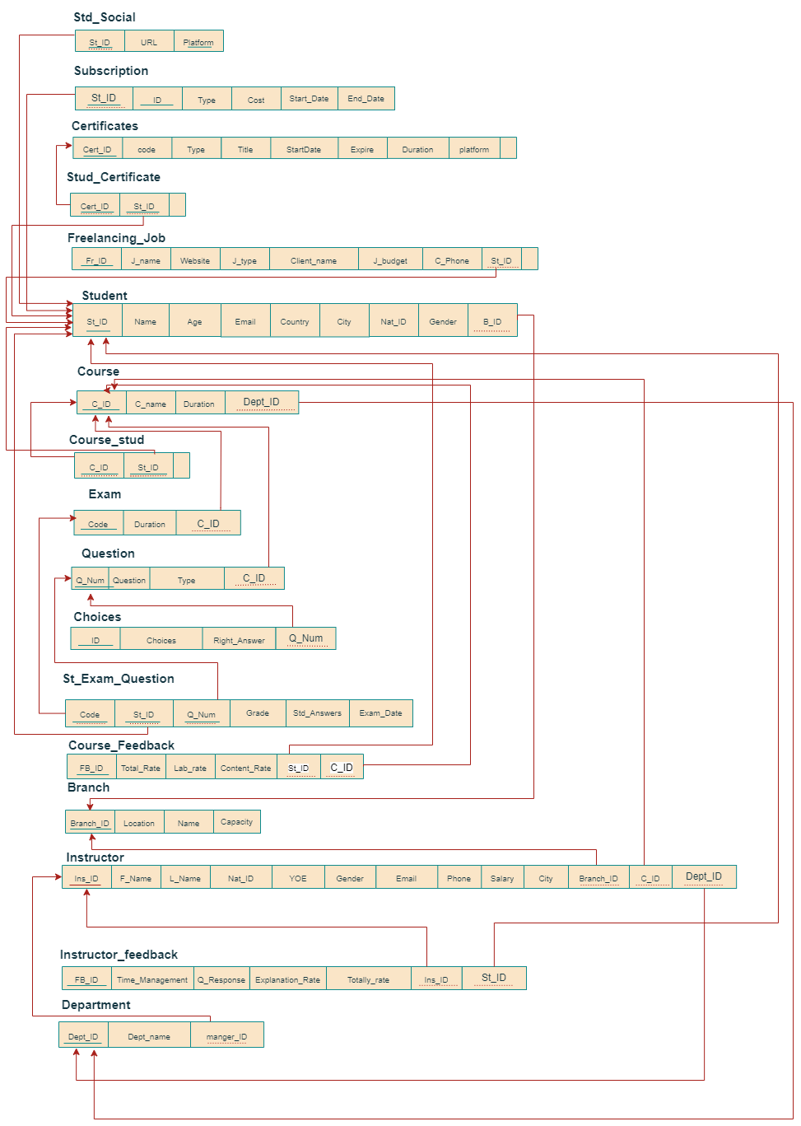
Key Entities and Relationships
Student, Subscriptions, Certificates and Freelancing: Stores information about students, including their subscriptions, certificates, and social media links.
Course and Feedbacks: Defines the courses offered and it feedbacks, which are linked to instructors and students.
Instructor and Feedbacks: Manages instructor details and it feedbacks, including their assignments to various courses.
Exam, Questions and Choices: Represents the exams associated with each course, containing questions and linked student submissions.
Department and Branch: Organizes courses and instructors under various departments and branches.

Slide 10

2. Create Database

Slide 11
2. Create Database | Schema
The activities in this phase included:
Creating tables and establishing primary and foreign key constraints.
Implementing normalization rules to avoid redundancy.
Ensuring that the schema was optimized for performance and scalability.
Implement the database schema in an SQL environment.
This involved translating the ERD into a relational database structure, complete with tables, relationships, and indexes.

Slide 12
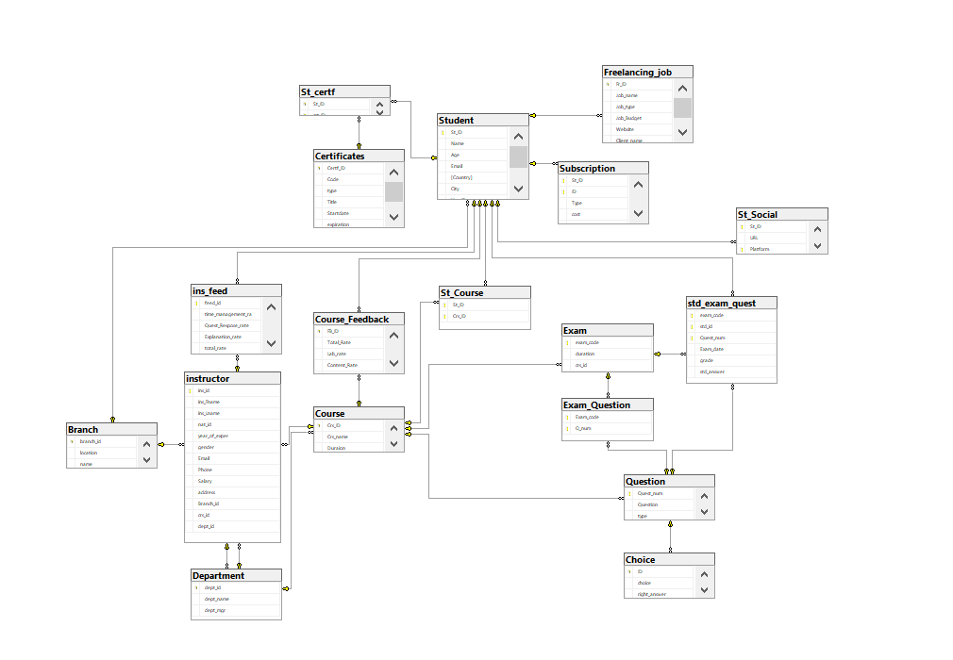

Slide 13

3. Create Procedure

Slide 14
3. Create Procedure
Key operations covered by the procedures included:
Stored procedures were developed to manage the core operations of the system.
These procedures automated tasks such as creating exams, submitting answers, correcting exams, and generating reports.
CRUD Operations (Create, Read, Update, and Delete): Managing data related to students, courses, instructors, and exams.
Exam Management: Automating the generation of exams, storing student responses, and calculating grades.

Slide 15
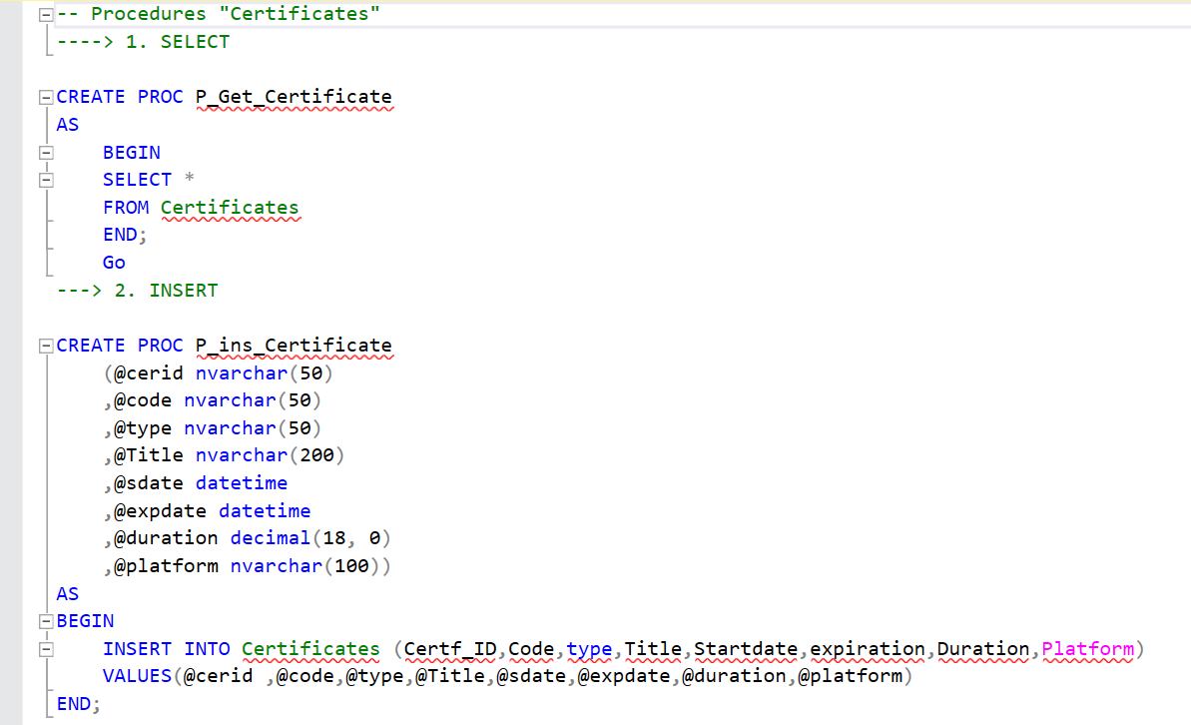

Slide 16
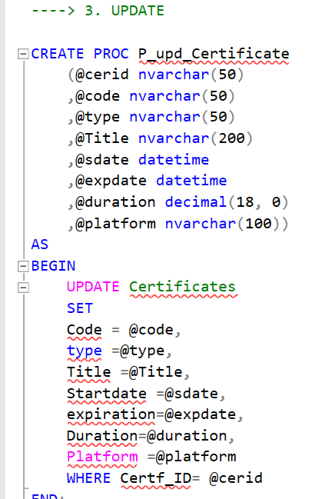
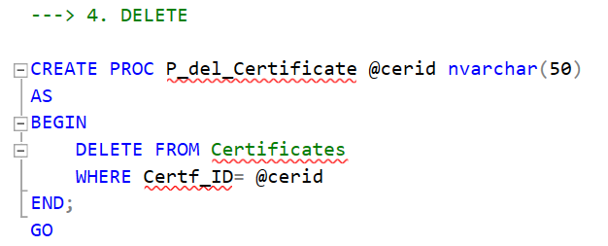

Slide 17
Exam Procedure
EXAM Generation
EXAM Correction
EXAM Answers
Exam Procedure

Slide 18
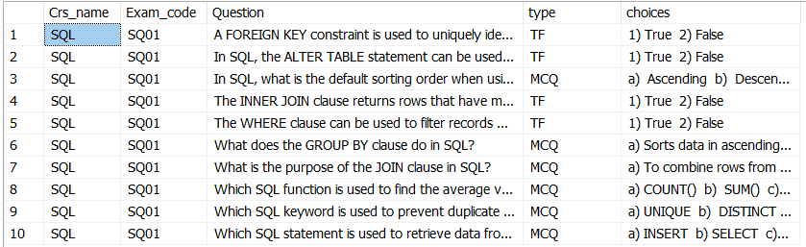
-----Generate EXAM-------
Create PROC Generate_EXAM @crsname nvarchar(50)
AS
BEGIN
SELECT Crs_name, Exam_code, Question, type,
STRING_AGG(choice, ' ') AS choices
FROM Course C
JOIN Question Q
ON C.Crs_ID = Q.CID
JOIN Exam_Question EQ
ON EQ.Q_num = Q.Quest_num
JOIN Choice cc
ON cc.quest_num = Q.Quest_num
WHERE Crs_name = @crsname
GROUP BY Crs_name, Exam_code, Question, type;
END;
EXEC Generate_EXAM 'SQL'
EXEC Generate_EXAM 'Data Structure'
EXEC Generate_EXAM 'Illustrator'
EXEC Generate_EXAM 'HTML/CSS'
EXAM Generation

Slide 19
-- EXAM Answers
CREATE PROC ST_Answer_EXAM @examid nvarchar(50),@stid decimal(18,0),@Qnum nvarchar(50), @answer nvarchar(100)
AS
BEGIN
INSERT INTO std_exam_quest (exam_code,std_id,Quest_num,Stud_Answers)
VALUES(@examid,@stid,@Qnum,@answer)
END;
SELECT *
FROM std_exam_quest
EXEC ST_Answer_EXAM 'DS02',1002,'Q25','a) O(1)'
EXEC ST_Answer_EXAM 'DS02',1002,'Q31','2) False'
EXEC ST_Answer_EXAM 'DS02',1002,'Q32','1) True'
EXAM Answers

Slide 20
--EXAM Correction
CREATE PROC EXAM_Correct @exam_code NVARCHAR(20), @std_id decimal(18,0)
AS
BEGIN
UPDATE std_exam_quest
SET Grade =
case
when Right_Answer=1 then 10
Else 0 end
FROM std_exam_quest sq join Question Q
ON sq.Quest_num = Q.Quest_num
JOIN Choice C
ON C.quest_num = Q.Quest_num
WHERE exam_code = @exam_code and std_id = @std_id and sq.Stud_Answers=C.Choice
END;
EXAM Correction

Slide 21

4. Data Collection

Slide 22
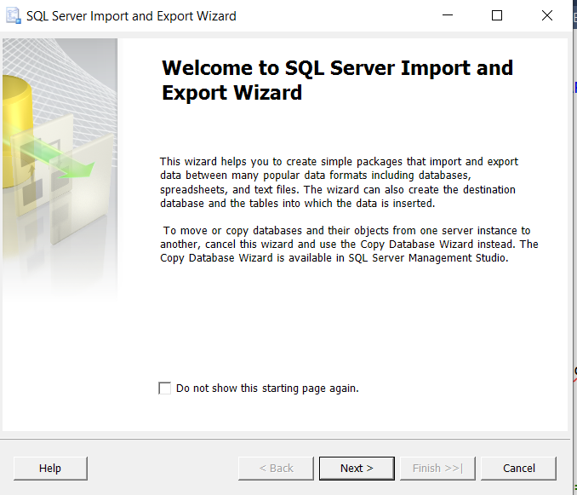
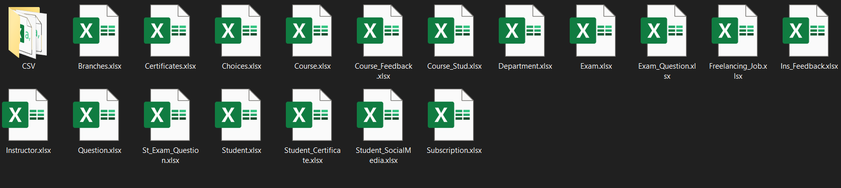
Data Excel File
Database

Slide 23

5. Reporting

Slide 24
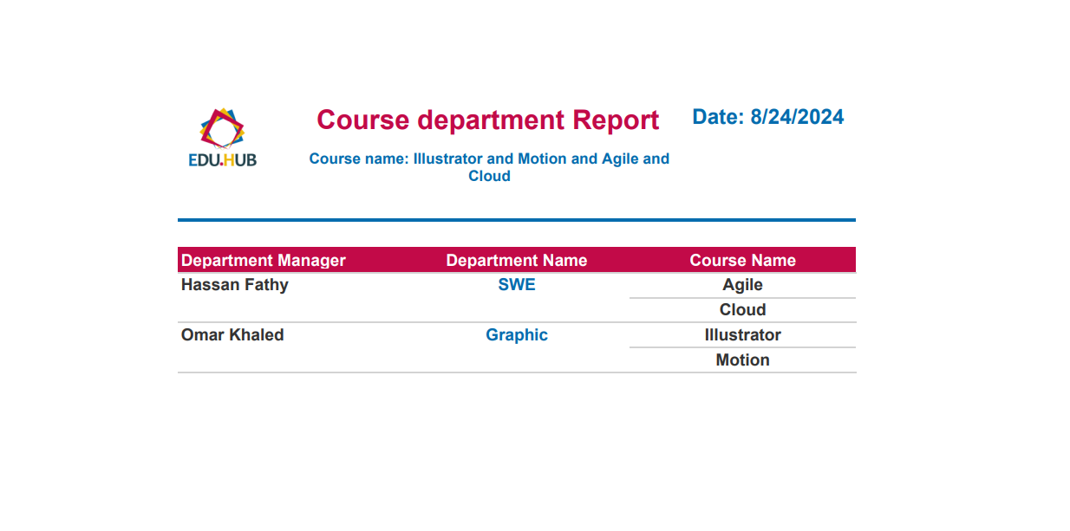
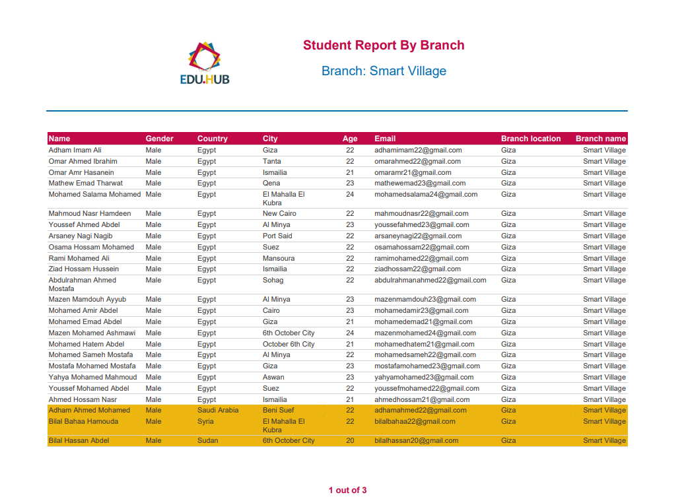
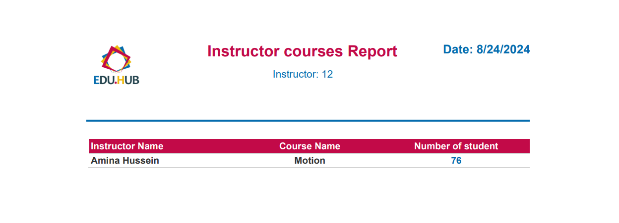

Slide 25
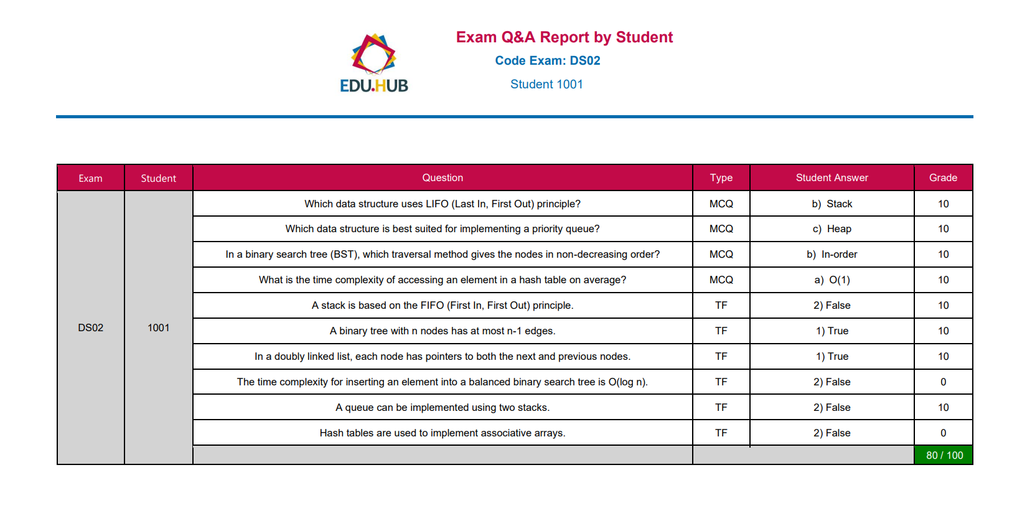
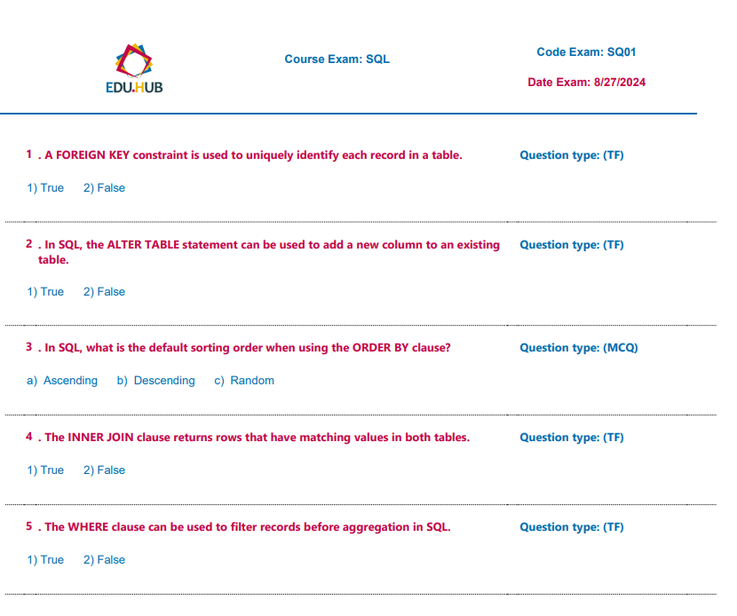

Slide 26

6. Dashboards

Slide 27
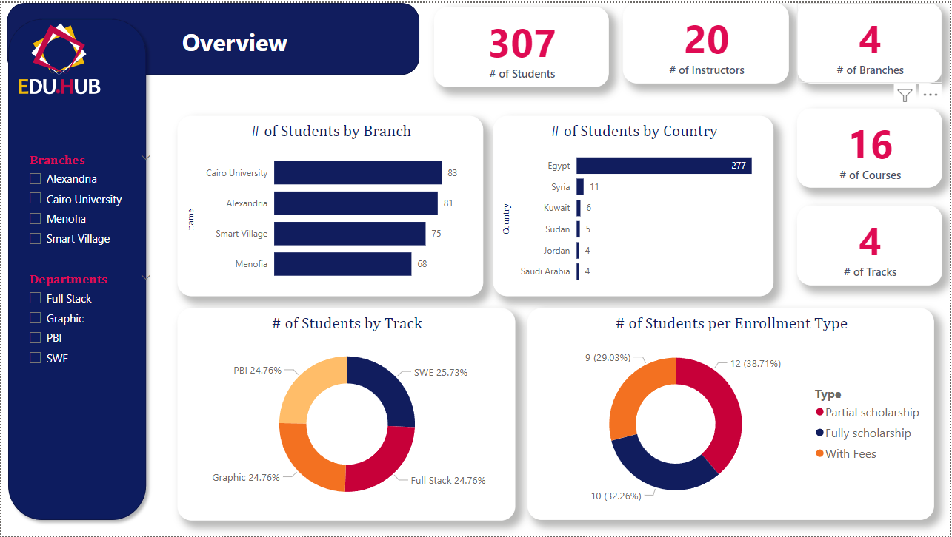

Slide 28
Student Dashboards

Slide 29
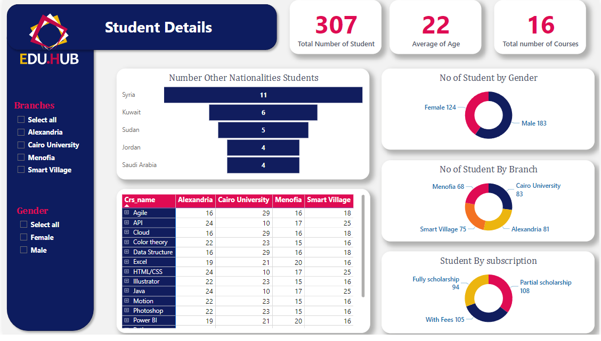
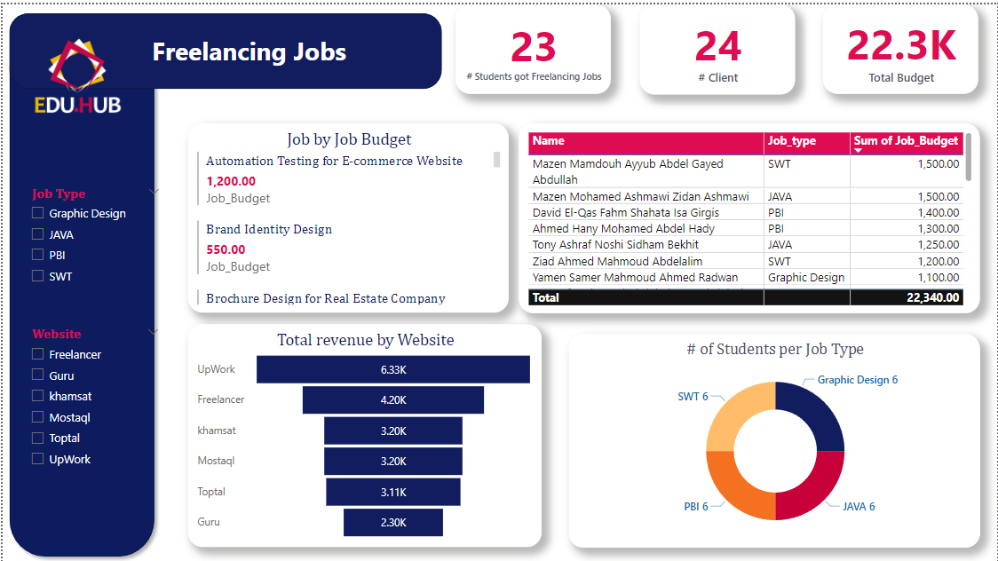
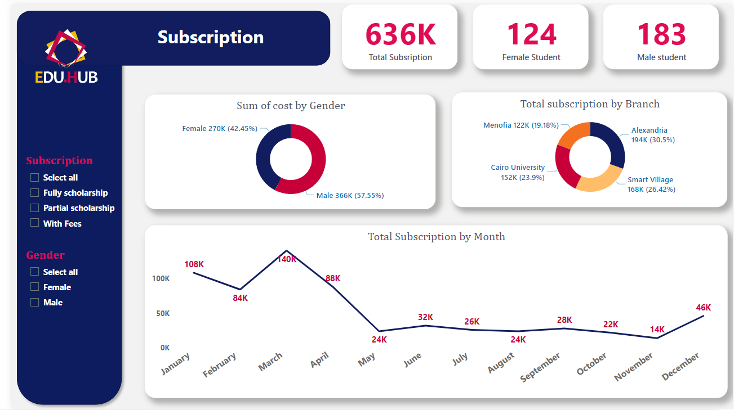
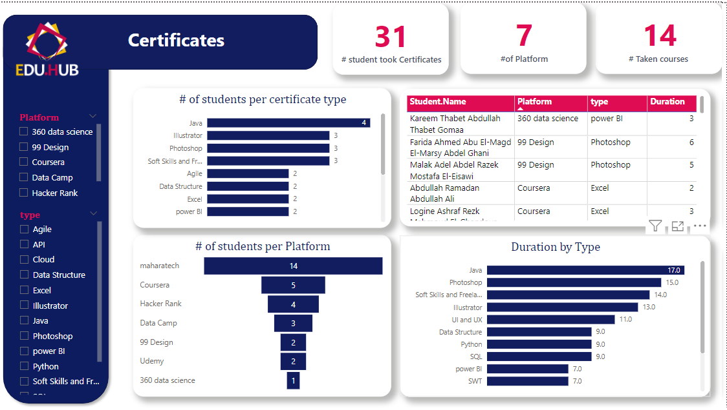

Slide 30
Instructor Dashboards

Slide 31
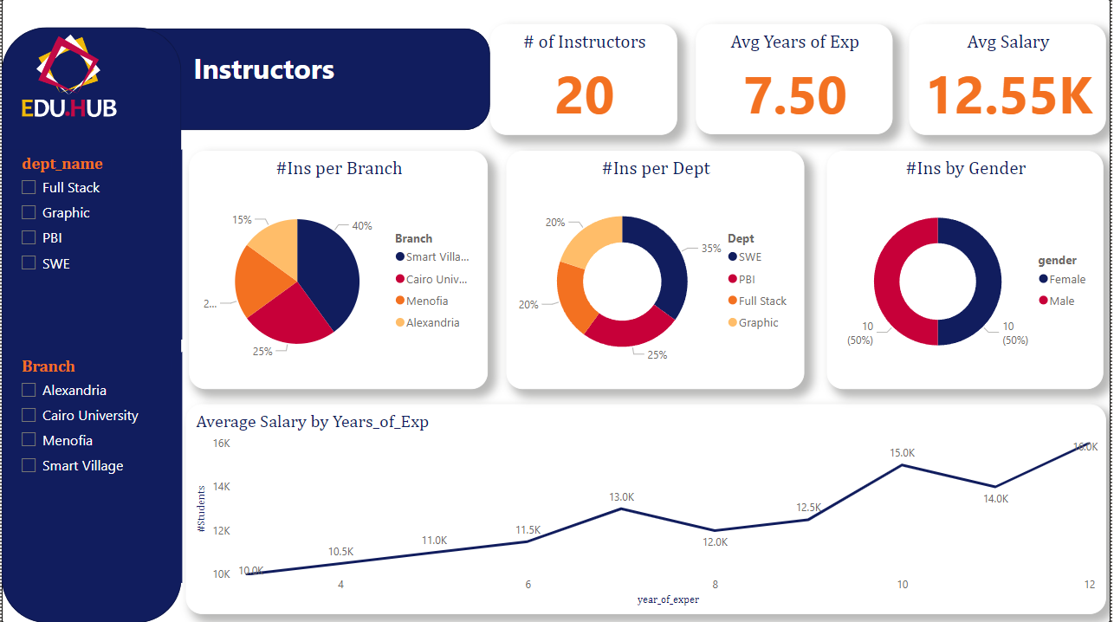

Slide 32
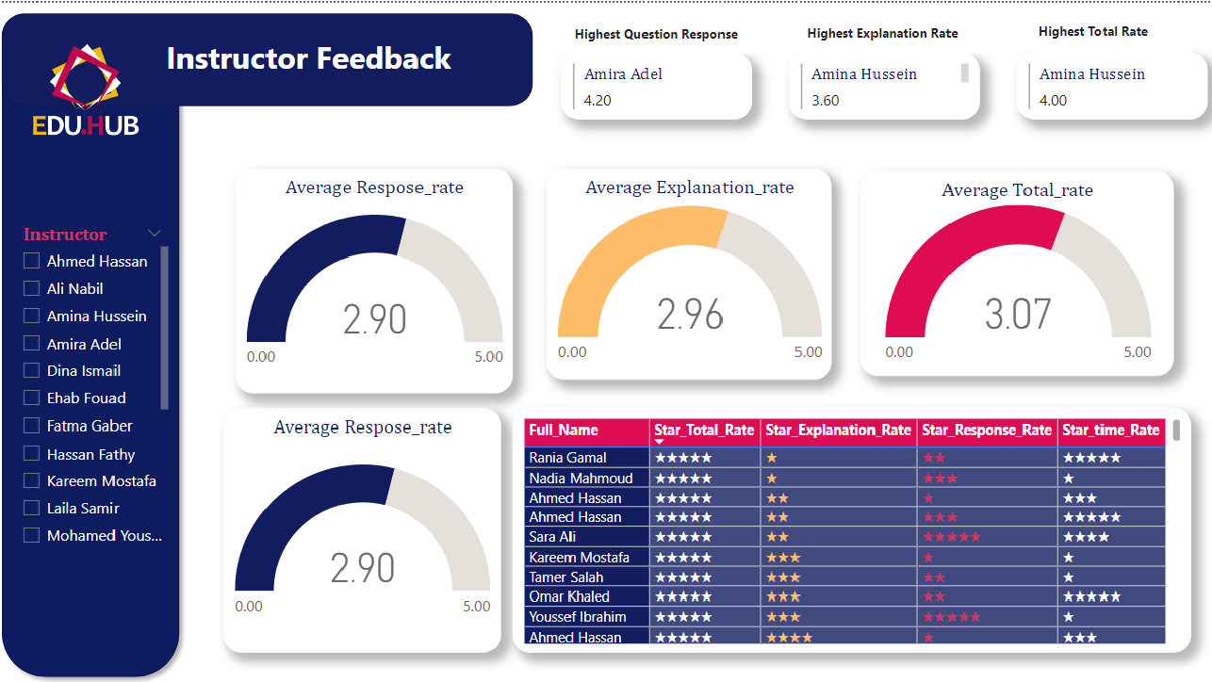

Slide 33
Courses Dashboards

Slide 34
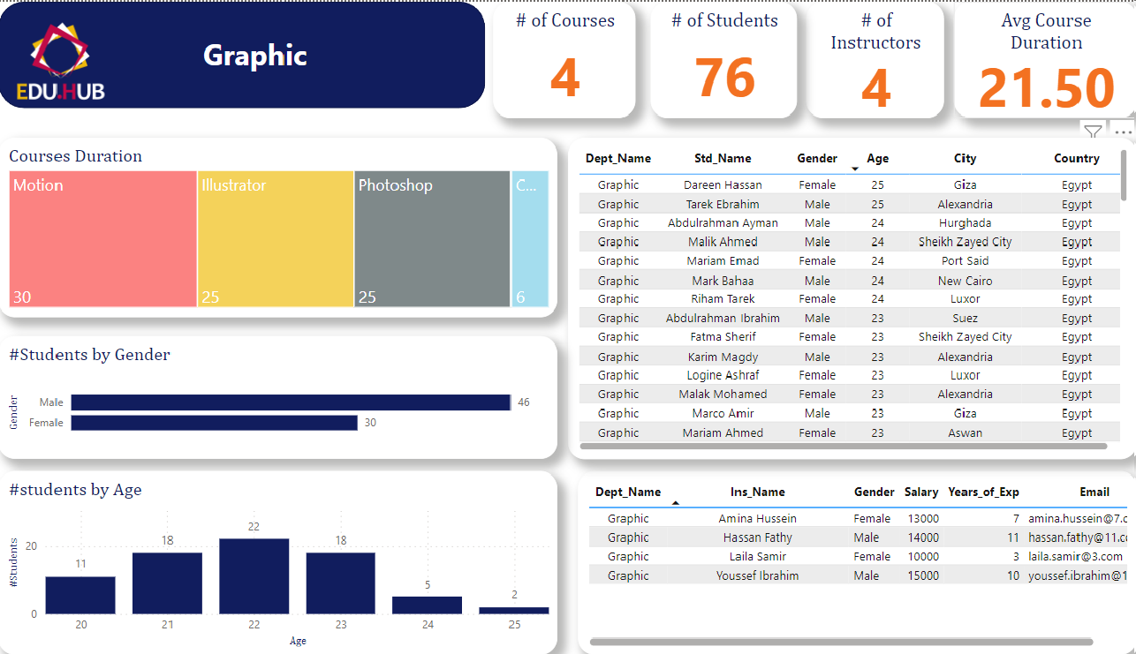
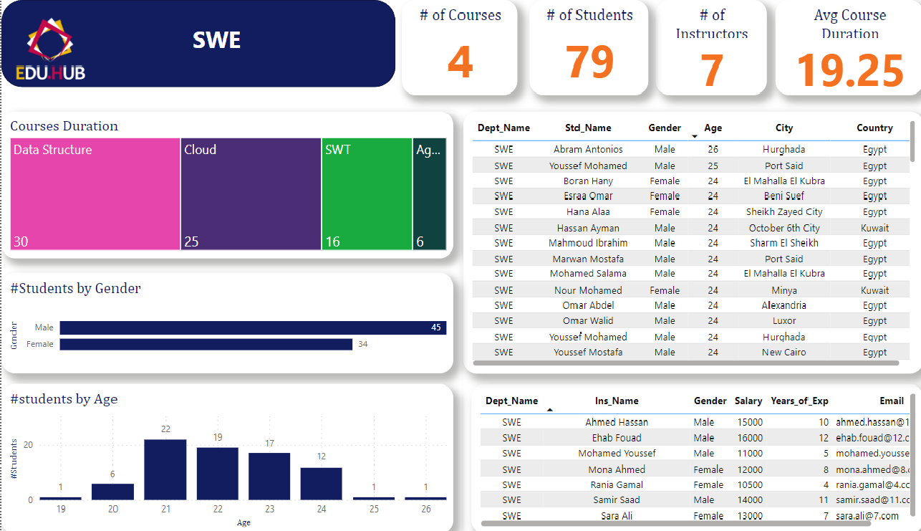
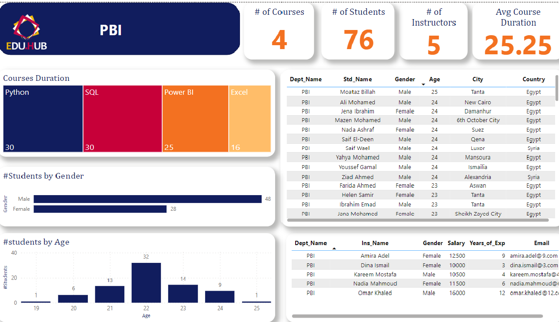
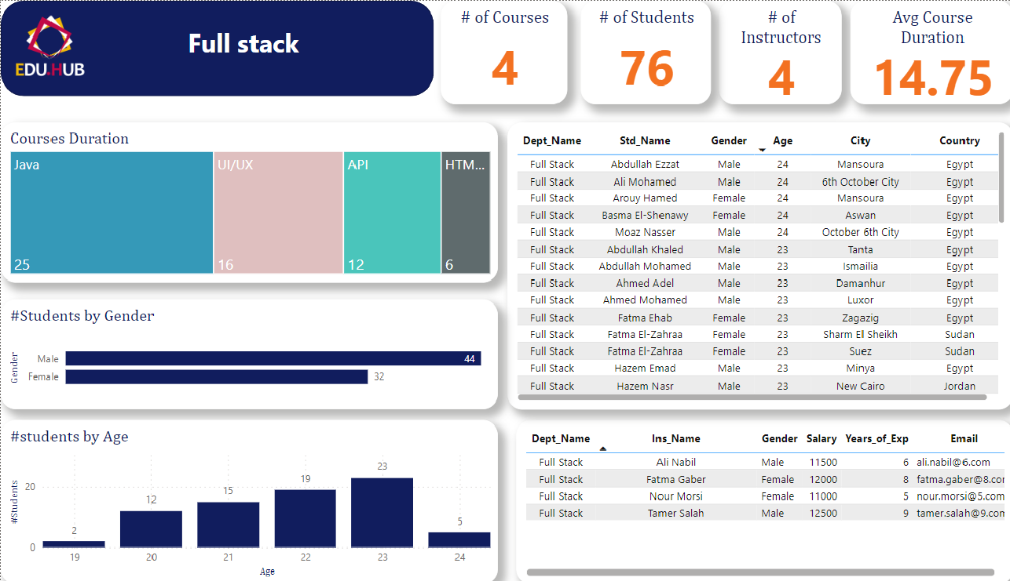

Slide 35
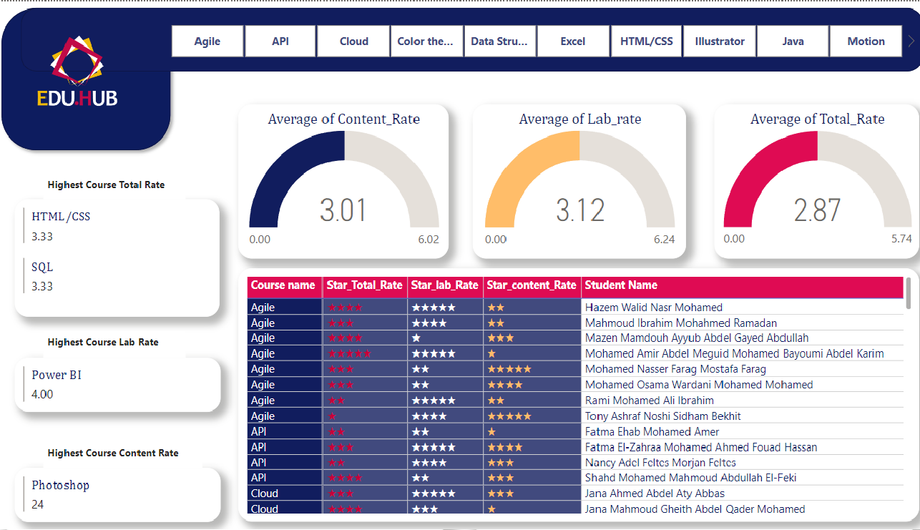

Slide 36
Social Media Dashboards

Slide 37
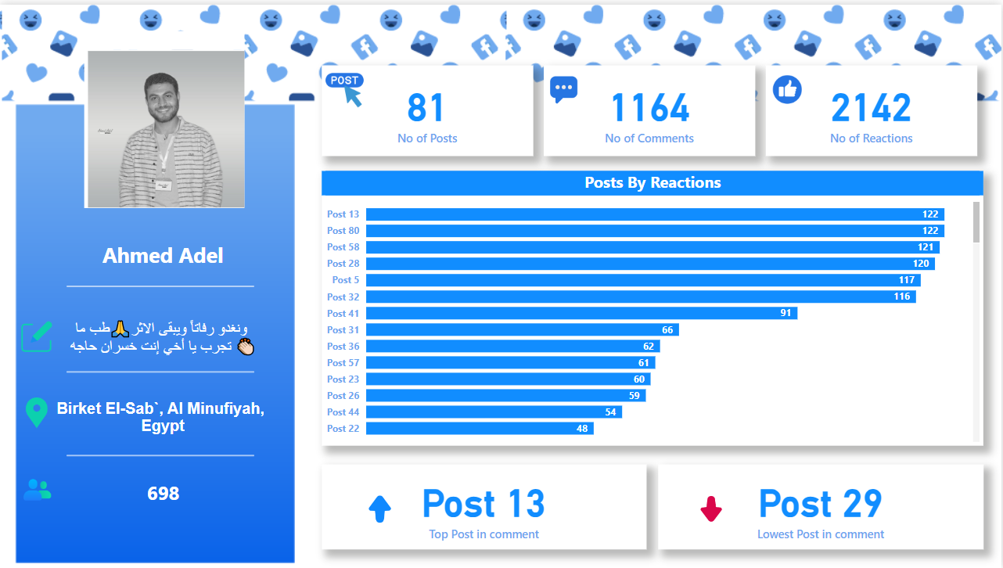
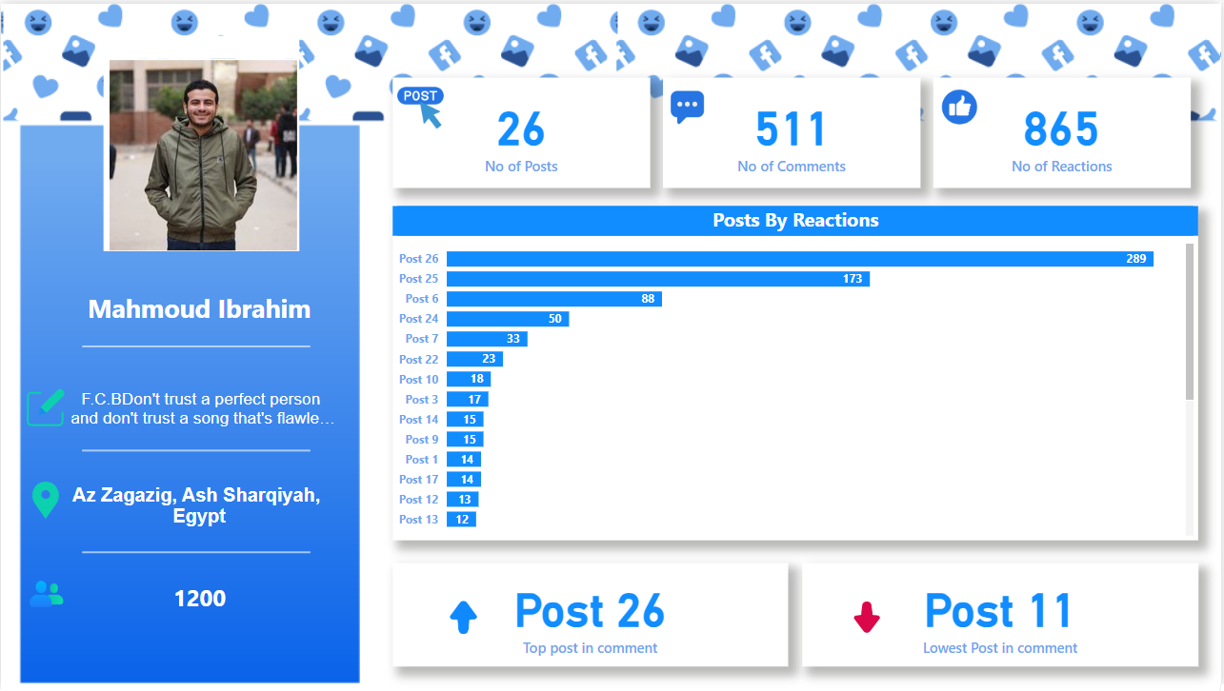
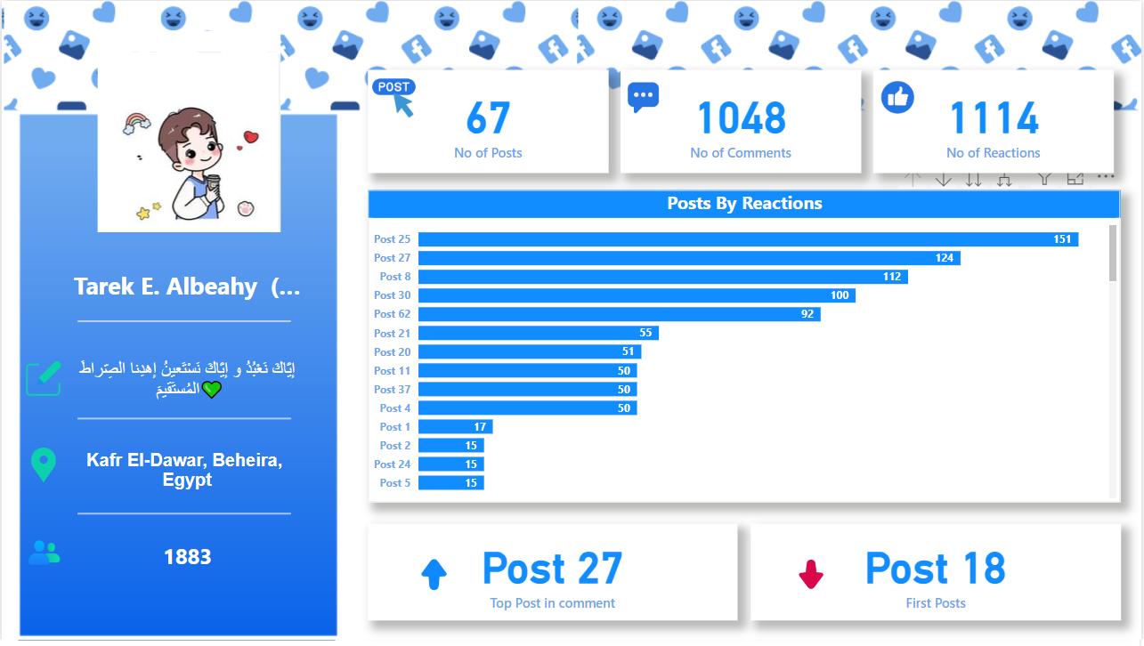


Slide 38

Project performance Tracking

Slide 39


Project performance Tracking
Tasks | Ahmed | Ali | Tarek | Mahmoud
ERD & Mapping
Create database
Collect Data
Procedure
Reporting
Dashboards
Documentation

Slide 40
Project Timeline
3 Days
Planning and ERD & Mapping
2 Days
Create procedures and test it
3 Days
Data Collection and implement it into Database
2 Days
Reporting (study the criteria) and
implementation
5 Days
Dashboards and its design

Slide 41
Thank You

